Slide 1
Ensuring Datapath Integrity and Adherence with Formal Security Verification in RISC-V Implementation
Sven Beyer, Keerthikumara Devarajegowda, Joerg Grosse, Nicolae Tusinschi
Siemens EDA, Germany

Slide 2
Importance of Hardware Security
Crucial to thoroughly verify hardware security features
Designs containing security features that must be verified
Application
58%
Safety Critical ASIC
+4%
since 2020
Software level
Operating System …
49%
Safety Critical FPGA
+5%
since 2020
Microarchitecture / RTL
Hardware level
Security is a topic at every layer of a system operation
Hardware is the foundation of all secure applications
Hardware with vulnerabilities compromises the whole system
Hardware must ensure the sanctity of secure operations
Gate / Physical / Layout …
Notes:
Importance of Software Security
1. Protection Against Cyberattacks
2. Safeguarding User Privacy
3. Trust and Customer Confidence
4. Reduction of Financial Losses
Importance of Application (HW) Security
1. Supply Chain Security
2. Protection Against Evolving Threats
3. Compliance Requirements
4. Secure Development Lifecycle

Slide 3

Security Verification Challenges
Confidentiality
  Internal data buses are vulnerable to external tampering
  Data leakage
Sneak Path
Represent significant risk compromising control systems
  Data corruption
  Control compromise
Verifying Security Features
Integrity
  Data sanctity is critical
Verification Methods
  Simulation does not scale, traditional formal suffers from increased efforts and expertise
  Data inversion
  Methodology
  Complexity
Difficulty
Highly complex and convoluted nature of designs rule out expert inspection of paths
Inversion
Secret data must not reach illegal points unencrypted

Slide 4
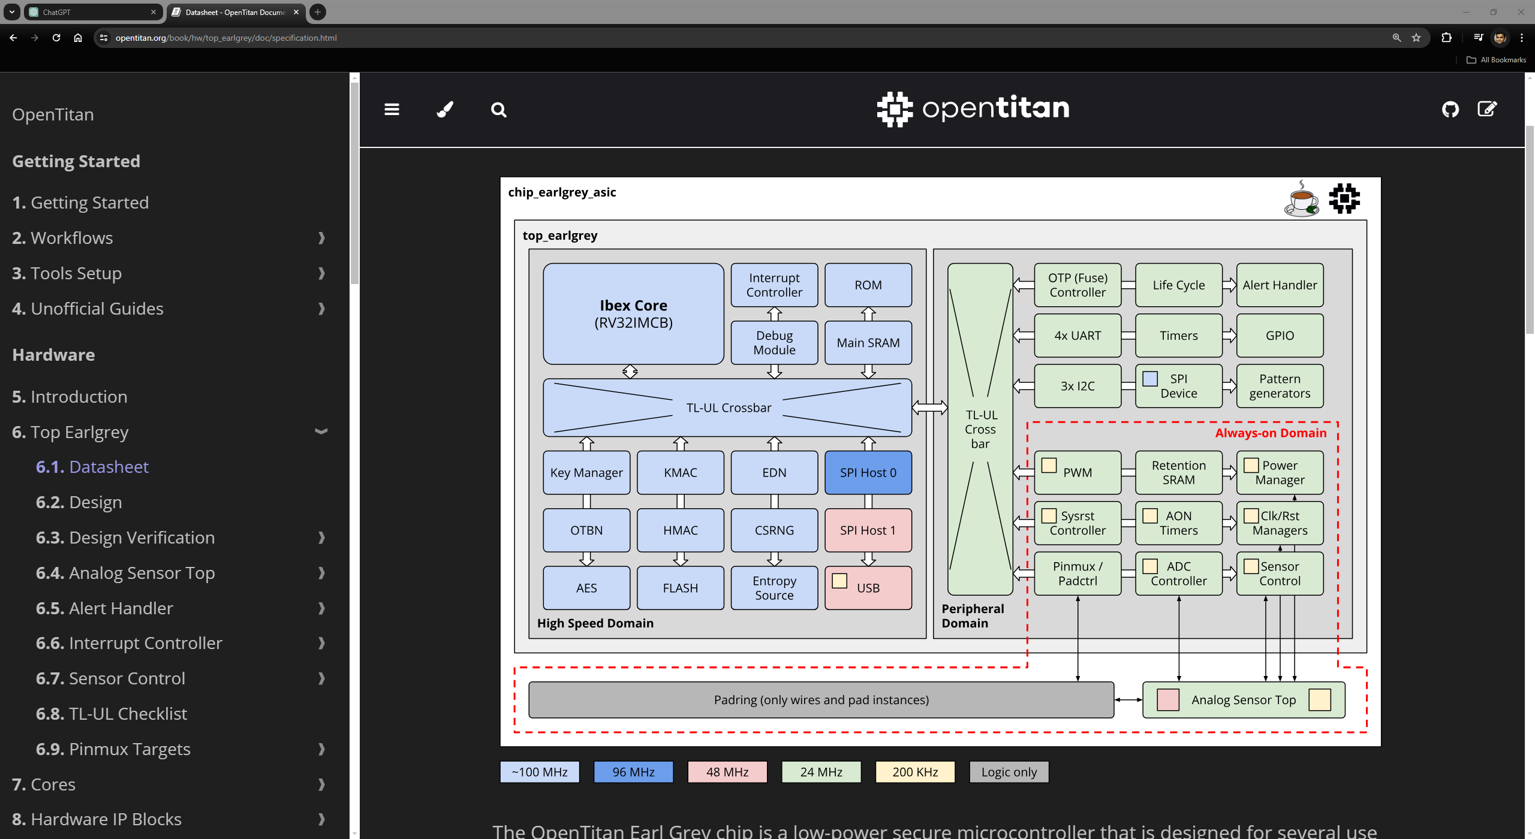
OpenTitan
An open-source project aimed at creating a highly secure, transparent, and flexible Root of Trust (RoT) hardware design
The design is scalable to meet the security needs of a wide range of applications, from small IoT devices to large data center hardware.
Clean RTL implementation with several
  Hardware Features for Security:
  Secure storage, Side-channel attack resistance, Secure boot, Cryptographic acceleration, Antitamper mechanisms, etc.
Notes:
OpenTitan is the first open-source silicon root of trust (RoT) chip design.
A root of trust is a set of functions in a computing device that is always trusted by the operating system (OS).
The main goals of OpenTitan are to enhance transparency, security, and flexibility for hardware design (making it suitable for a wide range of devices from IoT gadgets to data center hardware).
The design is scalable to meet the security needs of a wide range of applications, from small IoT devices to large data center hardware.
Implements several functions to ensure hardware security like Secure storage, Side-channel attack resistance, Secure boot, and so on….

Slide 5
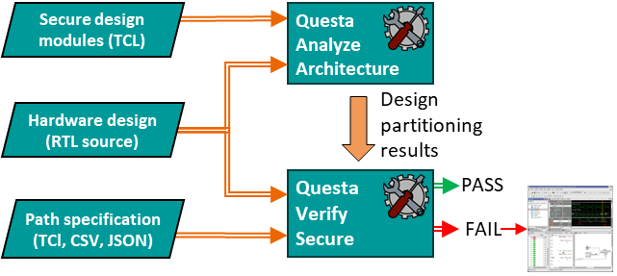
Methodology Overview
Formal-based solution
Formal Verification
  Guarantees security requirements for datapaths through systematic and exhaustive analysis
  High degree of automation speeds up the verification process
Formal solutions applied
  Questa Analyze Architecture (QAA) - For design partitioning
  Questa Verify Secure (QVS) - For exhaustive datapath analyses

Slide 6

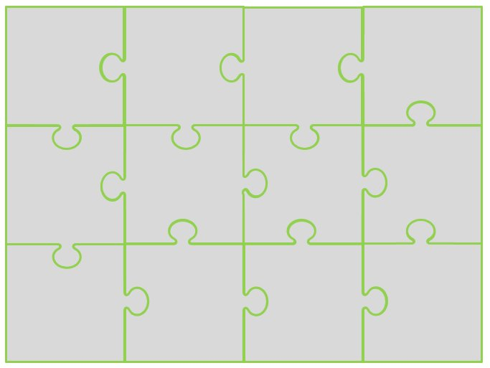
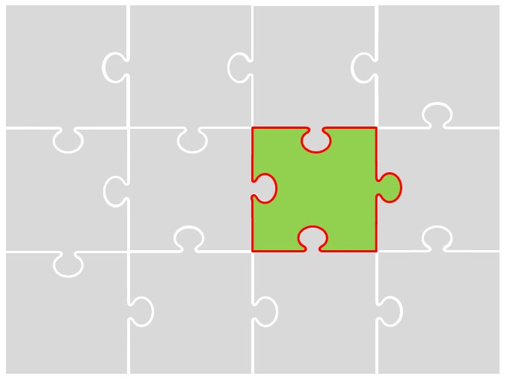
Methodology Overview
Design partitioning through architecture exploration
Crucial to understand/analyze the design architecture to extract the cluster of security sensitive modules
Questa Analyze Architecture (QAA) enables architectural exploration
  Simplifies understanding of complex designs
  Isolates specific design instances for focused or targeted security analysis
Partition through
model creation
Structural verification of the model
Functional verification of the model
Large IP/SoC
Notes:
Typical secure hardware design include secure part/modules and non-secure parts/modules.
Due to large and complex nature of design, it is highly unlikely that a single engineer (even designers) have the full picture of the design.
So it is imperative to understand and explore the design to create or formulate cluster of design parts that are sensitive to secure elements.
QAA enables design exploration and is scalable to very large designs.
QAA reads the RTL design and provides user-friendly commands to isolate parts of design.
For example, one could ask QAA which are all the instances that are influenced by the AES data output.
Based on the outcome, one can proceed with structural or functional analysis.

Slide 7
Methodology Overview
Datapath specification
Define paths that secure data should or should not traverse within certain design instances
DUV
RSA
E
D
B
CA
A
do these paths exist, which violate the security datapath requirements?
Notes:
The first step is to define which paths secure data should traverse and which paths it should avoid.
This is crucial for ensuring that sensitive information flows only through secure and intended channels.
As depicted in the diagram, we have various data paths labeled A through E, with green paths indicating secure routes and red paths highlighting potential security violations.

Slide 8



Methodology Overview
Datapath analysis
Questa Verify Secure (QVS) is a formal app for running exhaustive datapath analyses
Automation
Generate properties from high-level path specifications
Identify ports and black box signals subject to potential security issues
Exhaustiveness
Run path analysis with cutting-edge formal methods
Debug
Pinpoint debug of vulnerable paths
Root cause identification with waveform analysis

Slide 9
Application on OpenTitan
RTL sources @ https://opentitan.org
Focused on chip_earlgrey_asic version with top_earlgrey module
Architecture exploration
  Used Questa Analyze Architecture to explore the architecture of OpenTitan with a focus on AES and OTBN modules
  Outcome is a list of design instances that have potential dependency on the data from AES and OTBN instances
Path analysis
  Specified paths from AES and OTBN secure data ports to all instances connected to the TL-UL Crossbar

Slide 10
Application on OpenTitan: AES instance
The AES unit is a cryptographic accelerator that accepts requests from the processor to encrypt or decrypt data
Communication with the processor happens through a set of CSRs
The AES unit includes a separate interface through which KeyManager can provide the key without exposing it to the processor or other hosts attached to the chip interconnect bus.
Notes:
Add more details here if needed during presentation and explain a bit about AES and OTBN

Slide 11
Application on OpenTitan: AES instance
Data source | Data destination | Outcome | Runtime
AES instance | Ibex core data interface | Functional datapath present | 152s
 | Ibex core instr. interface | -- | Timeout
 | SPI | -- | Timeout
 | UART | -- | Timeout
 | RV-PLIC | -- | Timeout
 | Debug module | Functional datapath present | 174s
 | Main SRAM | -- | Timeout
 | ROM | -- | Timeout

Slide 12
Application on OpenTitan: AES instance (with QAA)
Application of QAA helped in creating a design cluster
Ibex-core, debug module, Key manager, TL-UL Crossbar are the design instance that form a design cluster with the AES instance
With this information, we could abstract away all other design instances for the formal path analysis

Slide 13
Application on OpenTitan: AES instance (with QAA)
Data source | Data destination | Outcome | Runtime
AES instance | Ibex core data interface | Functional path present | 62s
 | Ibex core instr. interface | Functional path absent | 25s
 | SPI | Functional path absent | 25s
 | UART | Functional path absent | 25s
 | RV-PLIC | Functional path absent | 25s
 | Debug module | Functional path present | 123s
 | Main SRAM | Functional path absent | 25s
 | ROM | Functional path absent | 25s

Slide 14
Summary
Formal-based methodology effectively helps to safeguards complex digital systems
Suitable for security verification in large SoCs
Questa Analyze Architectures simplifies the application of formal methods
Questa VerifySecure provides comprehensive path analysis
Future Work
  Further automation in the methodology
  Refinement for increasingly larger System on Chips (SoCs)

Slide 15
Datapath requirements in Secure designs
Confidentiality
secret data from A should not leak to B
DUV
Integrity
RSA
data from C should not overwrite secret data at A
E
D
Sneak path
B
CA
A
combination of confidentiality (sneak-out) and
integrity (sneak-in) checks
Data inversion
do these paths exist, which violate the security datapath requirements?
secret at D should not reach port E without encryption

